Slide 1
EENG 385 BJT Curve Tracer Calibration
Notes:
Usually the <title of the lab> is what will be called the “System” through the rest of this document

Slide 2
Lab Objectives
Objective: Finish assembly of BJT Curve Tracer and use it to measure the gain and Early voltage of three BJTs.

Slide 3
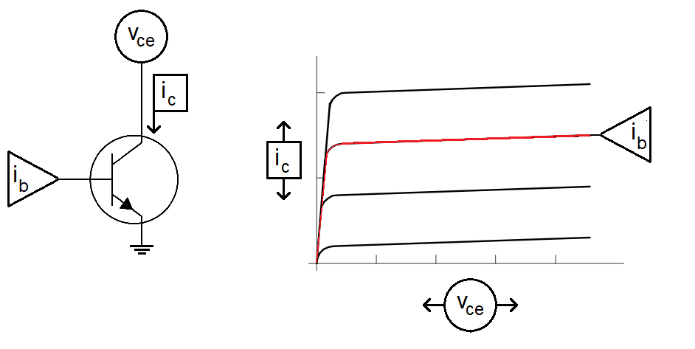
Theory
Device Under Test = DUT
Draw family of characteristic curves on oscilloscope
Provide vce and ib as inputs then measure ic as the output
Notes:
Replace <System> with the name of the

Slide 4
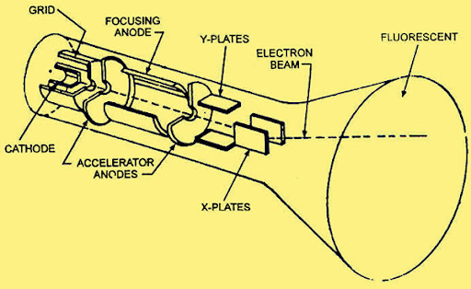
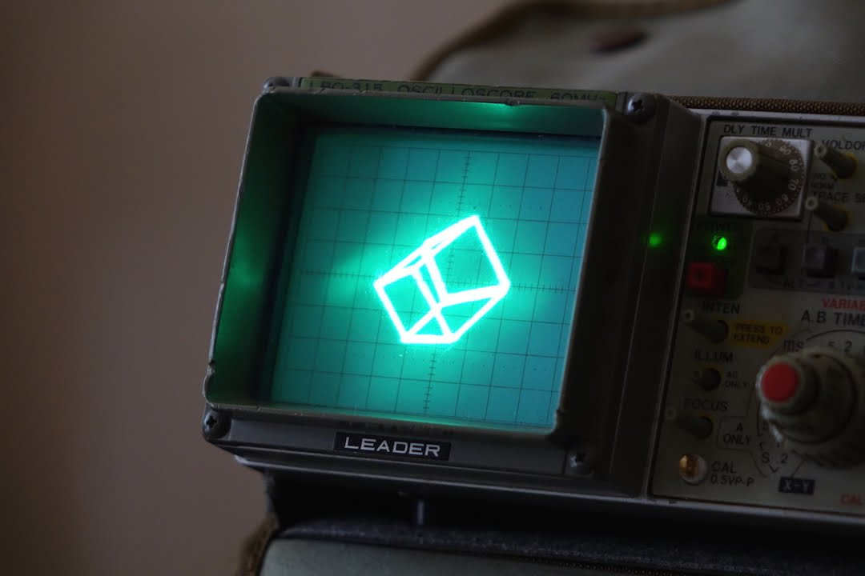
Theory
Imagine oscilloscope drawing an image using a beam
Oscilloscopes used CRTs
X-position of beam
Controlled by voltage on Ch1
Y-position of beam
Controlled by voltage on Ch2
Can create complex images
IC vs. VCE family of curves
Notes:
Replace <System> with the name of the

Slide 5
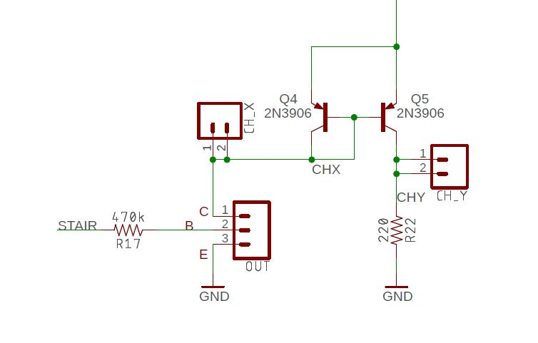
Analyze
Ramp - 0.7V is applied to collector of DUT
Current mirror converts ic into voltage across 220Ω
VSTAIR is converted to base current through 470kΩ
You will measure the voltage of each step convert to base current
You can do this before soldering in components
Step | V_{STAIR} | i_{b} (uA)
9 | 8.03 | 15.6
8 | 7.84 | 15.2
7 | 6.95 | 13.3
6 | 6.06 | 11.4
5 | 5.07 | 9.3
4 | 4.18 | 7.4
3 | 3.29 | 5.5
2 | 2.39 | 3.6
1 | 1.41 | 1.5
0 | 0V | 0
Notes:
Replace <System> with the name of the

Slide 6
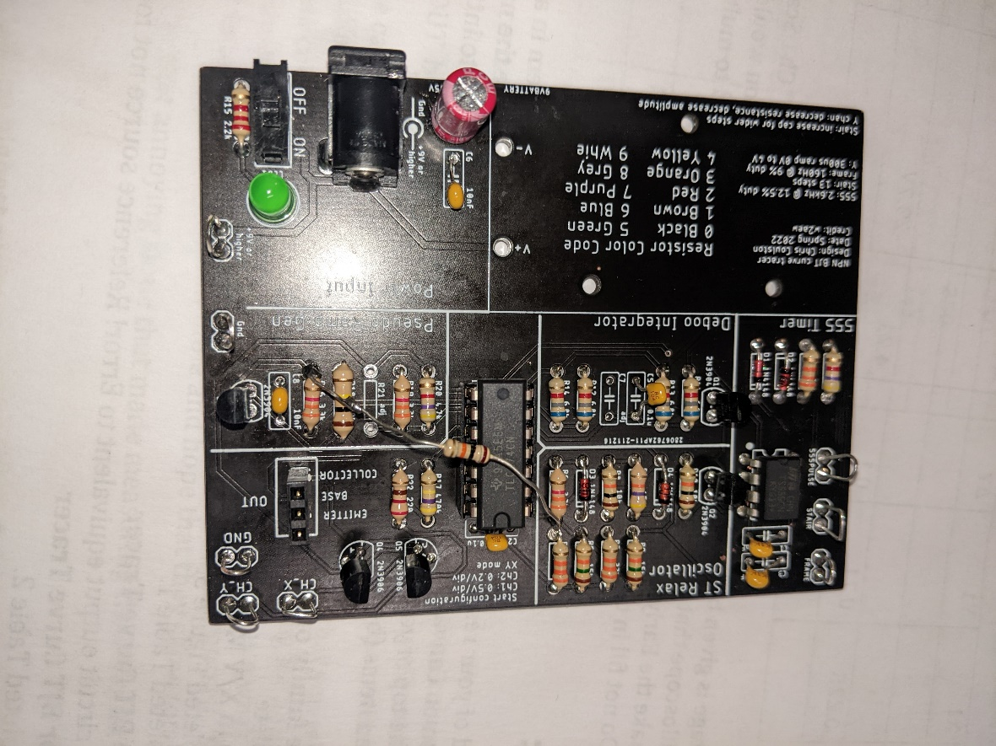
Assemble
Two 2N3906 PNP in 385 parts bin
One 2N7000 NPN in 385 parts bin
Misc. resistors and 3-pin DUT socket in parts bin
Use resistor leads for GND, CH_X and CH_Y loops
Notes:
Replace <System> with the name of the

Slide 7
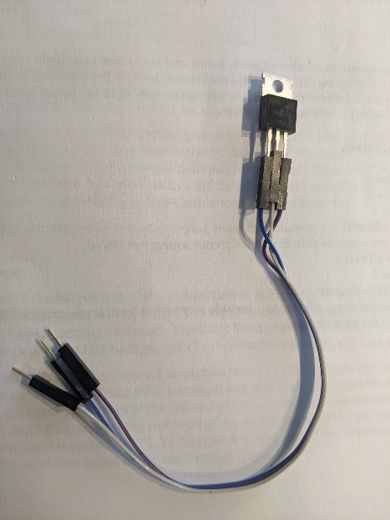
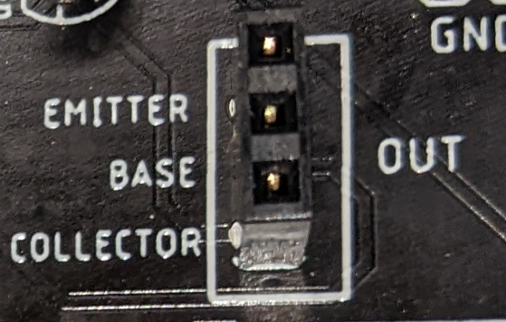
Test
Different BJTs will have different pinouts
Will not harm DUT BJT if you put it in backwards
Check datasheet for pinout
Use jumper wires as needed
Notes:
Replace <System> with the name of the

Slide 8
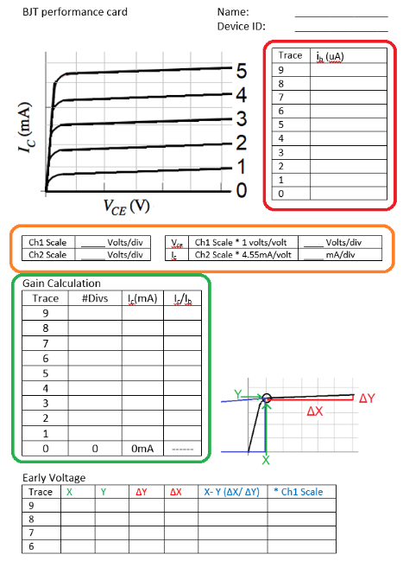
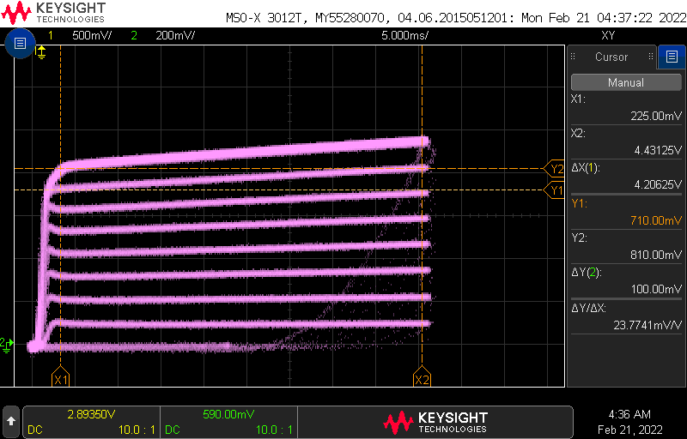
Test
Base current from Table
Scale from scope
Measure i_{c} at v_{ce} = 1V
Use cursors for Early voltage
Notes:
Replace <System> with the name of the

Slide 9
Turn In
This is an individual assignment
You can work in teams of two during this lab
Fill out 3 BJT Performance Cards for:
2N2222 or 2N3904 (in 385 parts bin or Blue cabinet in 305)
BD139 or TIP41C (in 385 parts bin)
Random NPN BJT you find lying about
Save BJT card as PDF
Due before start of class next week
Every student uses their own board
Everyone brings their board to class

